Slide 1


nalytics
Your convos,
our interpretations
Yes, we delve into
your personal business ;-)

Slide 2
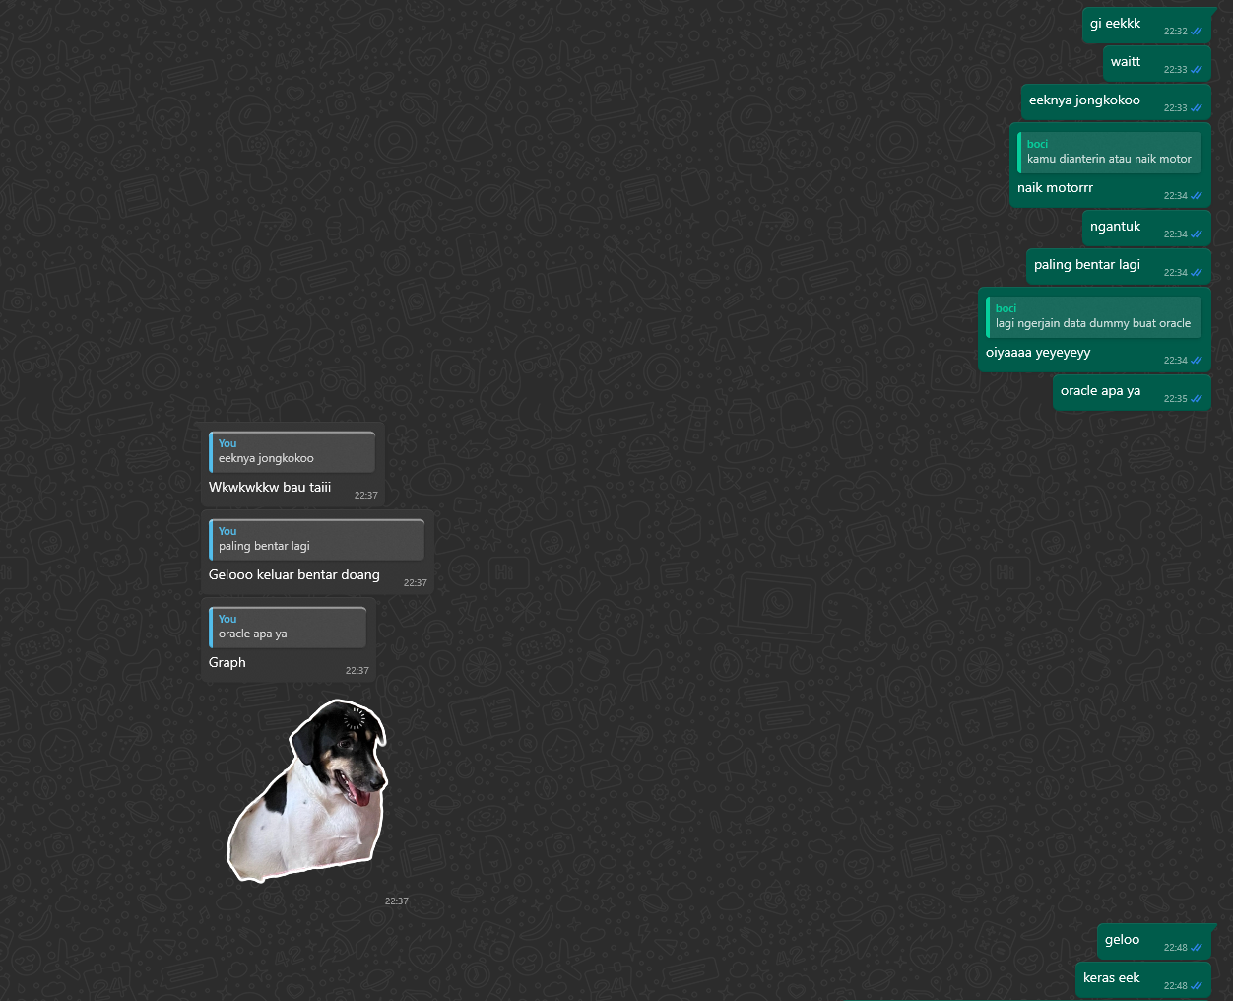
From nonsense

Slide 3
To a bit of sense
(Next slide)

Slide 4
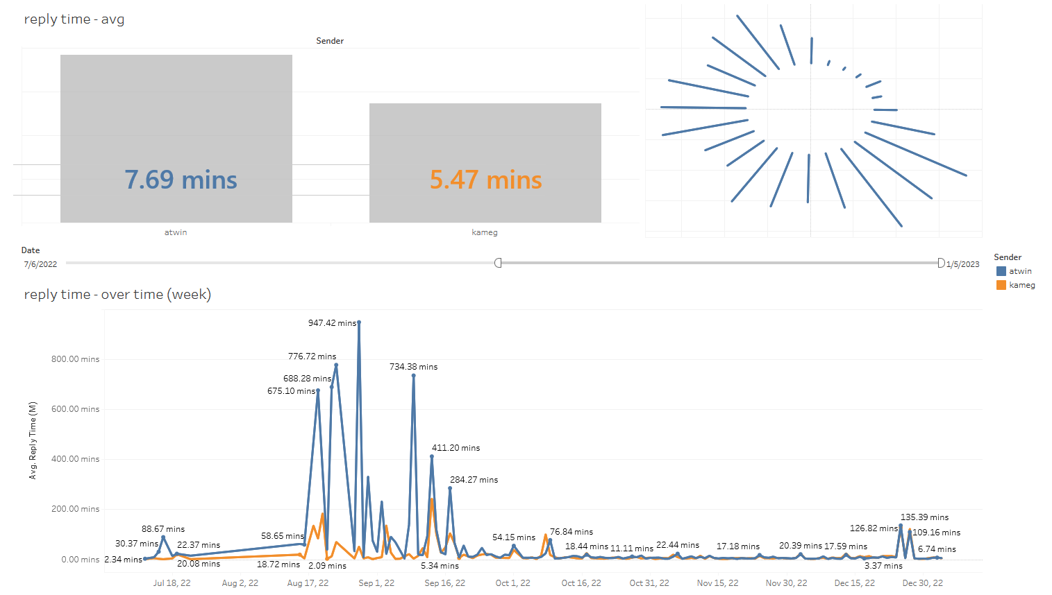

Slide 5
Next dev
User to upload their own wa chat
JS based viz
Ask your own messages, if that makes sense
Going public

